Slide 1
Lennon Lab Meeting
Venus Kuo
6/10/2016

Slide 2
Outline
Results of mini microcosm experiment
Greenhouse project
Suggestions on experimental set up? Other measurements?

Slide 3
Microcosm Experiment Goals and Set Up
Goal: To measure microbial activity in soil with Rpf addition
CO2
RPF
Soil

Slide 4
Microcosm Experiment Results
0, 24, 48, 72, 94, 126 hour readings
Rpf seems to increase CO2 respiration in soil but high/low levels doesn’t matter.
Water – live soil control not available
Two applications of Rpf

Slide 5
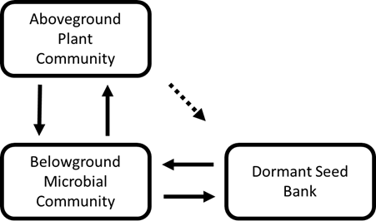
Greenhouse Project Background
Soil microorganisms structure plant community and drive productivity
Plants produce root exudates that structure the microbial community
Dormant microbes may be a reservoir of genetic and functional diversity

Slide 6
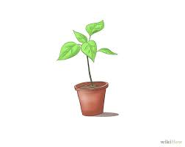
Greenhouse Project Goals
Goals: See if microbial activity and plant fitness is affected by resuscitated members of the seed bank by Rpf and soil training by plants
CO2
RPF

Slide 7
Experimental Set Up
Measurements: Flower and seed count, Specific leaf area (area:dry mass), biomass, CO2 respiration, CFU count
40 day growth period
Rpf and water application
Soil from Griffy Lake
2x2 factorial design w/ 2 levels
Suggestions on design? Power?
Rpf+
Rpf-
Rpf+
Rpf-
Sterile
N = 8
N =8
N = 5
N = 5
Live
N = 8
N = 8
N = 5
N = 5
With Plants
Without Plants

Slide 8
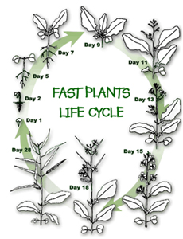
Experimental Timeline
Rpf applied every week (Every Monday)
Dilution plating and counting (Every Thursday)
CO2 measurement (Every Thursday)
Remaining soil samples are frozen
Plant Response Measurement:
Day 13-16: Count Flowers and Pollinate
Day 18: Measure SLA
Day 40: Count seeds and weight dry biomass

Slide 9
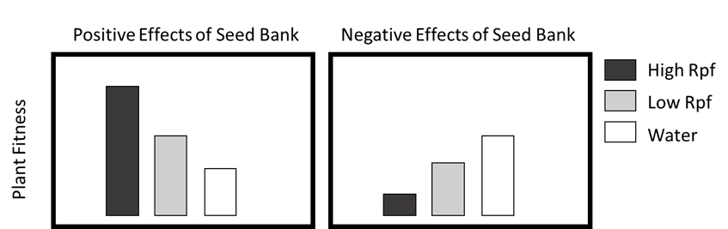
Fantasy Figures
High Rpf
Low Rpf
CFU/CO2 Respiration
Water
- Plants
+ Plants

